Slide 1
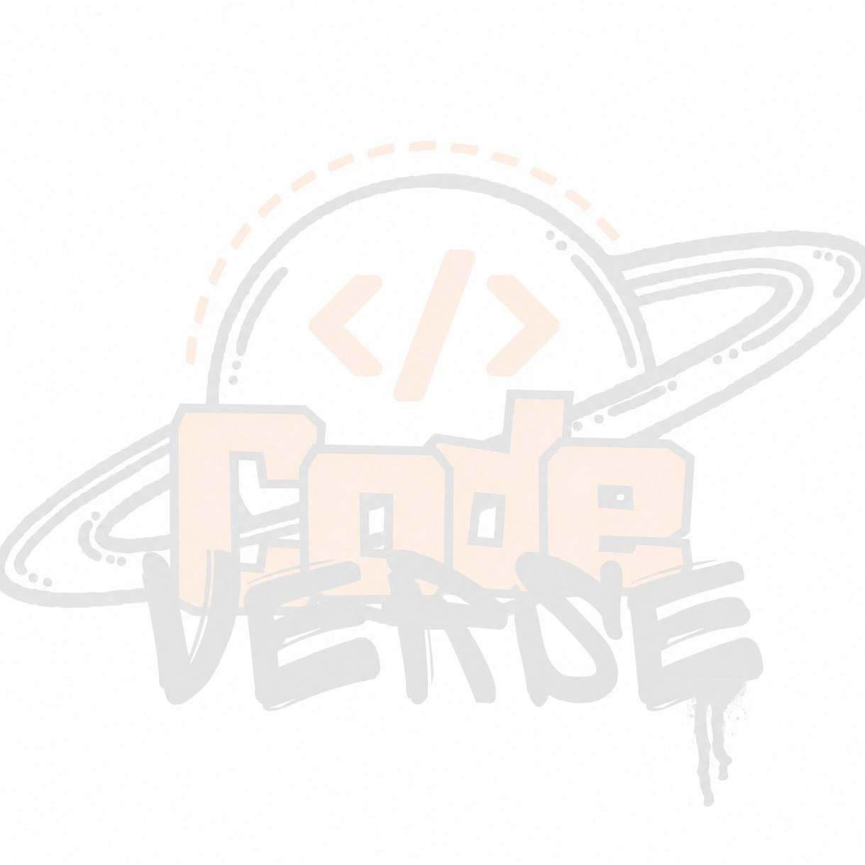





BUILD
भारत 4.0
WITH
NATIONAL LEVEL HACKATHON
TEAM NAME: GenerateZ
PROBLEM STATEMENT: Students struggle to discover collaborators whose skills complement not duplicate their own.
TEAM MEMBERS: Utkarsh, Rudraksh Porwal, Praveen Mishra, Ashmit Tripathi, Shaurya Tripathi
COLLEGE: Chandigarh University Uttar Pradesh

Slide 2
PROBLEM STATEMENT
• Students struggle to discover collaborators whose skills complement not duplicate their own.
• Project creators spend time searching manually and still lack confidence in fit, availability and commitment.
• Mentors and opportunities are fragmented across WhatsApp, college groups, LinkedIn and word of mouth.
• Result: Slower team formation, unequal access to opportunities and abandoned ideas.

Slide 3
SOLUTION
SkillBridge: A campus platform that translates skills, interests and project needs into clear recommendations.
1
Create a profile
Skills, interests, availability and portfolio links
2
Post or discover
Projects with roles, domain and timeline
3
Get explainable matches
See fit, gaps and match reasons
4
Build the team
Invite candidates and track missing roles

Slide 4
FLOW OF SOLUTION
Student profile
skills, interests, availability
Project brief
roles, requirements, timeline
Skill normalizer
taxonomy and related skills
Match ranking
weighted fit and team gaps
Team action
invite, accept, build
›
›
›
›
Explainability: every recommendation lists the skills, interests and availability factors behind the score.

Slide 5
TECH STACK
Web app
React / Next.js
Responsive interface
Backend
Node.js / Express
REST APIs and auth
Data
PostgreSQL
Profiles, projects, invites
Matching
Rule engine + embeddings
Explainable ranking
Integration
GitHub OAuth
Opt-in public metadata
MVP fallback: keyword and tag matching keeps the demo reliable if an external AI service is unavailable.

Slide 6
UNIQUE SELLING PROPOSITION (USP)
Most tools list people. SkillBridge helps form a balanced team around an actual project need.
Explainable recommendations
Students see why a match fits.
Complementary teams
Creators fill missing roles instead of collecting duplicate skills.
Campus context
Availability, learning goals and hackathon urgency guide discovery.

Slide 7
FEASIBILITY & COMPETITORS
24-hour MVP
Existing options
Risk controls
Profile • project post • rule matching • explanation • invite flow
Group chats are unstructured. Professional networks do not expose campus role gaps.
Consent-first GitHub import, user visibility controls, report/block flow and rule-based fallback.
Success will be measured during a pilot using time to first match, invite acceptance and team-role coverage. Prototype figures are illustrative only.

Slide 8
RESEARCH & REFERENCE
Research
Solution
References
There is a gap for a campus-focused platform that intelligently matches students, projects, teammates, and mentors using skills, interests, availability, experience, and team-role complementarity, while clearly explaining why each recommendation is made.
SkillBridge addresses this gap through explainable AI matching, role-gap detection, and structured project-based team formation.
Build With Bharat 4.0 rulebook
React / Next.js documentation
PostgreSQL documentation
GitHub OAuth documentation

